Slide 1
“Approved for Public Release”
National Industrial Security Program Policy Advisory Committee (NISPPAC)
NISPPAC Industry Updates
December 2021 Update
“Approved for Public Release”

Slide 2
NISPPAC 101
Industry’s Role on the NISPPAC
The NISPPAC was created 8 Jan 93, by Executive Order 12829, “NISP" Functions:
Advise the Chair of the Committee (ISOO, Director) on all NISP policies, including recommending changes
Serves as a forum to discuss policy issues in dispute.
Comprised of 16 government and 8 industry members
Two new industry members elected annually
Nominations by current industry NISPPAC & MOU members
Meets publicly at least twice a year
Creates Working Groups covering several NISP topic areas
Industry members represent ALL NISP companies (Small, Medium, Large, FFRDC/UARC, etc.) and not their own self-interest or company interest
Industry members are skilled in NISP Functions

Slide 3
NISPPAC Members
Who We Are
INDUSTRY
Heather Sims, Spokesperson | L3Harris
Aprille Abbott | MITRE
Rosie Borrero | SAIC
Derek Jones | MIT Lincoln Labs
Dave Tender | ASRC Federal
Greg Sadler | GDIT
Tracy Durkin | Mantech
Cheryl Stone | RAND Corp
INDUSTRY MOU
Kai Hanson | AIA
Jonathan Fitz-Enz | ASIS
Joe Kraus | CSSWG
Jordan Baxter | FFRDC/UARC
Kathy Pherson | INSA
Leonard Moss | ISWG
Lynn Burns | NCMS
Michelle Sutphin | NDIA
Marc Ryan | PSC
For the most up to date member listing, refer to archieves.gov/isoo.oversight-groups/nisppac

Slide 4
Industry NISPPAC Efforts=2 Years
Increased Engagements w/Industry, Gov’t and Congressional
Challenging Agencies that Are Creating Policy
Defined & Formalized Industry NISPPAC Representation
Reviewed and Implemented New and Existing Policy

Slide 5
Strategic Industry NISPPAC Priorities
TWF 2.0
CUI/CMMC
RMF
NISP Systems
CSA Processes/
Guidance
UNITING INDUSTRY’S VOICE
WORKING NISP ISSUES THROUGH FORMAL CHANNELS FOR IMPROVEMENT ACCOUNTABILITY

Slide 6
Current NISPPAC Working Groups
Sub-Working Groups
NISP Systems
Insider Threat
FOCI
Clearance
NISA
Policy
Sub-Working Groups
Sub-Working Groups

Slide 7
NISPOM Rule, 32 CFR, Part 117
Key Changes-How does it impact your company?
SMO Duties-applies to 100% of Cleared Companies
Incorporation of SEAD 3 reporting requirements-applies to 100%
TS Accountability- applies to less than 100 Cleared Companies
IDS Installation- applies to Cleared Companies that have IDS
Safeguarding-applies to less than 4000 of Cleared Companies
Classified Information Retention-applies to 100% Companies that have safeguarding
Section 842 Public Law 115-232-Gov’t-Foreign Companies w/Proscribed Information
Two Types of Limited FCLs-Gov’t
Granting FCLs-Gov’t
Tools
List of major changes in the preamble of the Rule
Cross Reference Tool
CDSE Webinar and Other Engagements
DCSA updating tools, oversight guidance/rating system and NISP systems
CSAs provided their NISPOM implementation plans at the April Public NISPPAC Mtg
Recommendations for Industry
ISL are not stand alone, READ and KNOW the POLICY
Make informed decisions
Use available tools
Ask for help/send in compliance interpretation concerns
WHAT ELSE REQUIRES FURTHER CLARIFICATION/GUIDANCE?

Slide 8
National Level Policy Updates
SEADs-ODNI
Draft DoD Security Acquisition Regulation
ISLs (not stand-alone documents)
SEAD 3- Adverse Information Reporting
32 CFR, Part 117
Usage of EPL List and Crosscut Shredders
Insider Threat
Top Secret Accountability
KMP Designation and SMO Training
CUI/CMMC Implementation
GSA Announcement of Black Label Phase Out (Black and silver label)
Phase out of GSA approved security containers and Vault Doors manufactured prior to 1989-Phasing out from 1954-1989
Over a period of 4 years starting as of October 1, 2024

Slide 9
Clearance Working Group
Industry NISP Priorities/Watch List
NISPOM, 32 CFR, Part 117/SEAD 3
Oversight-Compliance Updates from CSAs
What is reportable under SEAD 3?
SEAD 3 ISL-Foreign Travel
SMO training requirements
TWF 1.5 and 2.0
NBIS
Industry Requirements/Testing
Transition from DISS to NBIS
CV – 9/30 DNI Mandate
FCL process and Timelines (Metrics)
New Self-Inspection Handbook
DCSA Org Chart and Leadership Roles
Security-in-Depth

Slide 10
Insider Threat Working Group
Information Sharing
Items known by the Govt and sharing to Industry
All Security relevant information
May Cyber EO requires information sharing across Govt
2. DRAFT SEAD 9, Trusted Workforce, Whistleblower
3. SEAD 3 ISL Self Reporting
Consolidated Reporting for multiple agencies
Reporting to CISA and ISRs?
Adverse Information Reporting
4. Insider Threat Policy Implementation
How is the Govt measuring effectiveness?
Consistent Roll out
5. Mandatory COVID Immunization

Slide 11
NISP System Working Group
Consists of 5 primary sub working groups
JPAS-DISS
Lead: Jeremy Wendell
NBIS/e-APP
Lead: Quinton Wilkes
NCCS
Lead: Gregory Sadler and Amber Elliott
NISS
Lead: Lisa Reidy
SWFT
Lead: Jonathan Fitz-Enz
Other CSA Systems
eMass: Scott Taylor has been providing a liaison between the NISA working group and DCSA
As the need arises for coordination of additional CSA systems

Slide 12
NISA Working Group
Increased NAO/RAO Collaboration
eMASS Package Workflow Enhancements (CY 22)
More transparent tracking of submissions/approval process
RMF Package Approval Timelines
SCA Triage
NISP Connection Process Guide
Moving Forward.. Industry Priorities?

Slide 13
Evolving NISP Understanding Impact to Industry
Alignment/Unity of Industry on the Basics
Read/Understand the Policies
We don’t have to ask DCSA permission for everything!
Proactive Communication-Industry and Gov’t
What can we expect from our CSA?
New/Bad Processes=New Industry Burden
Engagement at all levels but at the right level!
UTOPIA!!! Industry self ID issues & partner w/Gov’t-Don’t operate in Fear
Approach when things are not working well!
TWF 2.0
RMF
DISS
CUI
FOCI
Supply Chain
Insider Threat
CMMC
NIST 800-171
NCCS

Slide 14
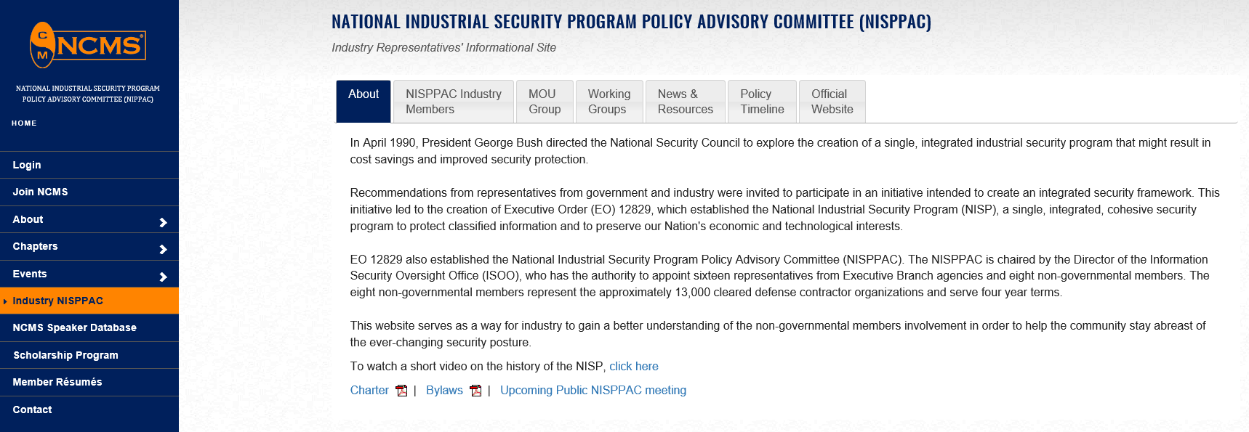
Industry NISPPAC on the Web
https://classmgmt.com/nisppac.php
Industry NISPPAC by email
nisppacindustry@gmail.com

Slide 15
QUESTIONS
???

